Slide 1
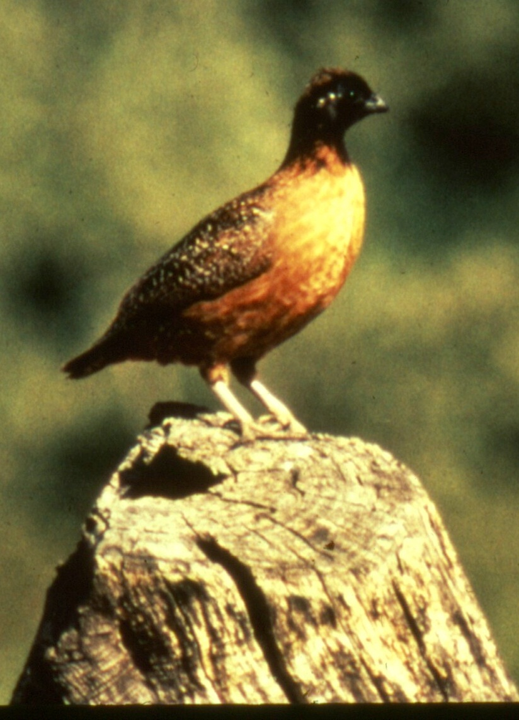
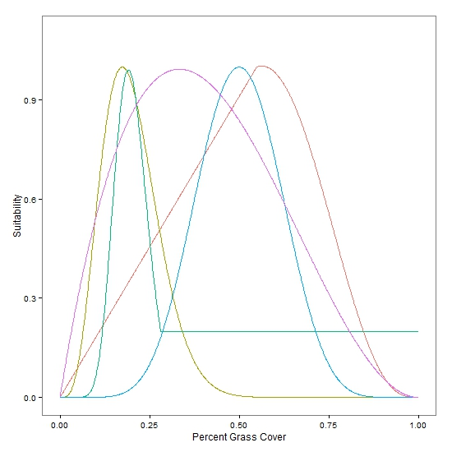
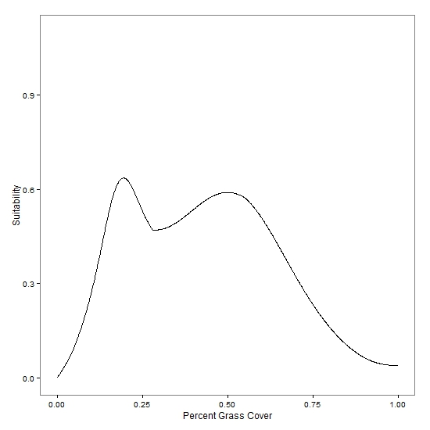
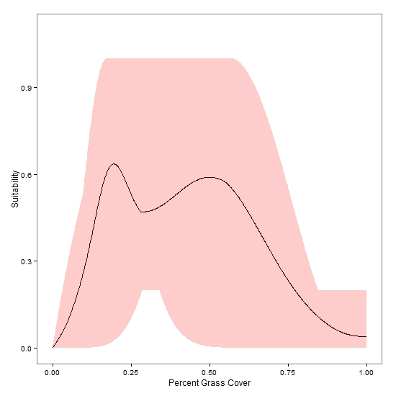
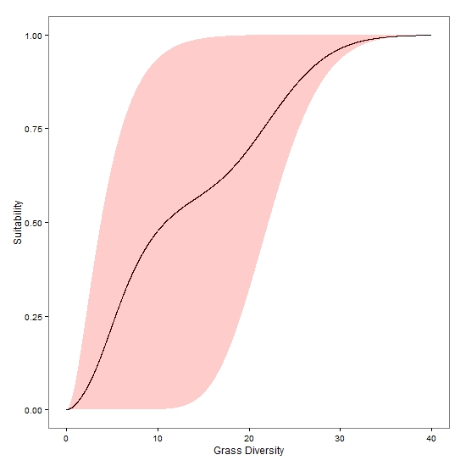
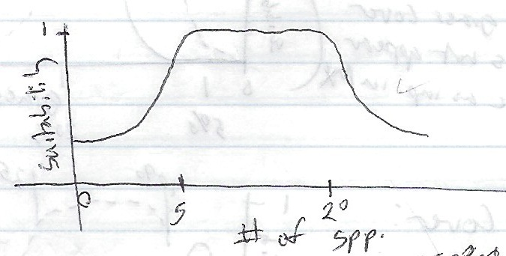
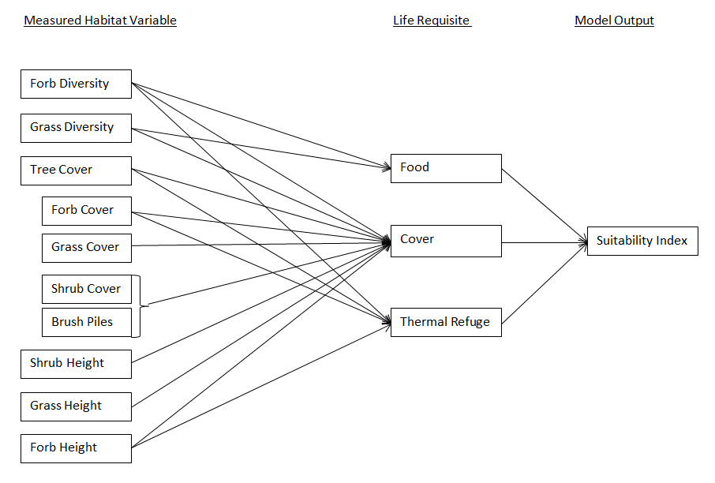
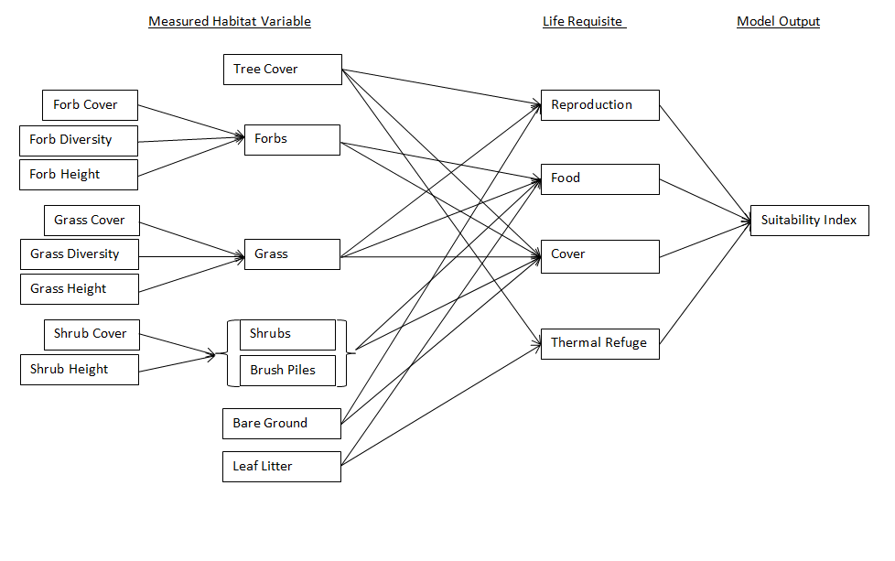
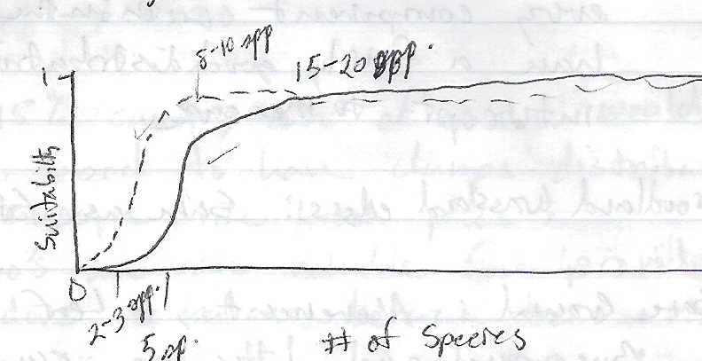



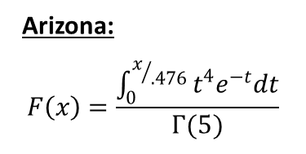
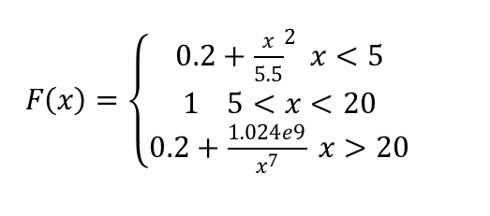


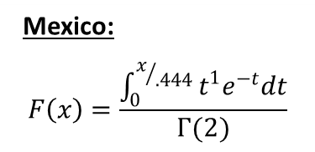
Developing a habitat suitability index model for a critically endangered bird:
understanding habitat suitability and uncertainty based on expert opinion
Dominic D. LaRoche, Statistics GIDP, Univ. of AZ and Courtney J. Conway USGS, Idaho Cooperative Fish and Wildlife Research Unit
Introduction
Endangered species pose unique challenges to land managers and conservation biologists. Endangered status implies a limited number of individuals or populations are available for study and the regulatory guidelines and protections associated with protected status can make collecting data difficult. Additionally, management decisions can have large impacts on the viability of an endangered species, emphasizing the need for accurate scientific recommendations. The Masked Bobwhite is an extreme example of these difficulties. The quail species was thought to have been extirpated from the U.S. by 1900 and recent surveys suggest that the remaining Mexican populations have also disappeared. The U.S. Fish and wildlife service has maintained a captive bred population and has tried, unsuccessfully, to reintroduce this species to its historical range in Arizona. Our goal is to develop a suite of habitat suitability index (HSI) models based on expert opinion and published literature and to quantify the uncertainty associated with these models so that managers can make scientifically informed decisions regarding optimal areas for reintroduction and habitat management.
Quantifying Uncertainty
Quantifying the uncertainty associated with these models will be very important as land managers attempt to improve masked bobwhite habitat or find new potential release sites. Multiple sources of uncertainty are associated with each HSI model:
Variable selection uncertainty
The nature of the suitability functions
The structure of the model
Relationships between variables
Importance of variables relative to one another
Latent variables (Food, Reproduction, etc.)
Measurement error of model inputs
We will focus our efforts on the quantification of uncertainty associated with (2) and (3). Understanding this uncertainty will not just help land managers make decisions about habitat management, but will also identify the habitat variables which contain the greatest degree of uncertainty. Understanding the greatest sources of uncertainty will be important for directing future research efforts.
What is an HSI model?
A program to develop HSI models for species of management concern was initiated in 1980 as a way to evaluate the likely effects of land and water use changes on wildlife habitat. HSI models are divided into three components: 1) written description, 2) graphical representation, and 3) mathematical representation (Fig 1). Typical HSI models combine both published literature and expert opinions into a single model to consolidate information from multiple sources into a single document. Unfortunately, development of a single HSI model for masked bobwhite may not be useful because of the diversity of expert opinion regarding their primary habitat requirements and the limited amount of published literature, most of which was conducted either during a period of severe population decline, or on captive-bred birds. Instead of developing a single model, we are developing a suite of habitat suitability models which will serve as plausible alternative hypotheses about the habitat suitability for masked bobwhites.
Photo by Roy Tomlinson
Uncertainty of Suitability Relationships
Past efforts to quantify uncertainty in expert opinions typically require the expert to explicitly specify their confidence. Unfortunately, an expert’s confidence in their own knowledge is likely to be a function of many factors, only one of which relates to the precision of their knowledge about the species habitat requirements. We are instead using the complete set of expert opinions to quantify uncertainty in the species habitat models (Fig. 3). Our current method assumes the “true” relationship is spanned by the set of expert opinions. Therefore, the degree of uncertainty surrounding any suitability function is defined by the entire set of functions across all species experts (Fig. 3).
Methods
Little information exists in the published literature regarding habitat requirements of the masked bobwhite so any HSI model for this species will need to rely heavily on expert opinion. We identified 12 species experts and were able to interview 9 of the 12 experts. Interviews were broken into two stages: 1) identification of important habitat variables, and 2) quantification of an HSI model based on the opinion of each expert.
Soliciting Expert Opinion- We used a novel approach to quantify expert opinion regarding the relationships between each environmental variable and habitat suitability of masked bobwhite. Language used by experts to describe these relationships is often qualitative and imprecise which hinders creation of a quantitative HSI model and contributes to uncertainty. Instead, we asked experts to draw these bivariate relationships in graphical form (Fig 1). This allows experts to precisely represent what they believe to be the relationship between a habitat variable and suitability for masked bobwhites. We then created a function which would closely match the expert’s drawing (Fig. 1). We also asked experts to specify the relationships between each of the environmental variables and habitat suitability for masked bobwhites. We represented these descriptions as acyclic graphical models (Fig. 2) and corresponding mathematical functions.
This method provides a good tool for visualizing the amount of uncertainty among experts regarding the importance of any specific habitat variable. However, this method assumes experts at the extreme range of opinions are only either over or underestimating the true relationship.
Future Improvements on this Method
This method ignores differences in the quality of expert knowledge which may be an important factor underlying estimates of uncertainty. Future refinement of this method will incorporate differences in expertise.
Additionally, information from the complete set of expert opinions will be incorporated into individual suitability functions. This will allow each model to be considered individually while still accounting for uncertainty.
a
b
c
d
e
f
$F\left(x\right)=\left\{\begin{aligned}0.2+{\frac{x}{5.5}}^{2} x<5 \\ 1 5<x<20 \\ 0.2+\frac{1.024e9}{x^{7}} x>20\end{aligned}\right.$
Figure 3. A comparison of the uncertainty in expert opinion between two habitat variables. Uncertainty among experts was greater for grass cover than for grass diversity and experts lacked consensus regarding an optimal value for grass cover.
Mexico: $$F\left(x\right)=\frac{\int_{0}^{x/{.444}}{t^{1}e^{−t}dt}}{Γ(2)}$$
$Food= \frac{GD+FD}{2}$, $Cover=\frac{{\left(FD∗FC\right)}^{1/2}+{\left(GD∗GC\right)}^{1/2}+TC+SC}{4}$
$$Thermal Refuge=\frac{{\left(FD∗FC\right)}^{1/2}+TC}{2}$$
$$HSI=Lowest score from Food,Cover or Thermal Refuge$$
$$Forbs \left(F\right)={\left(FC∗FD∗FH\right)}^{1/3}, Grass \left(G\right)={\left(GC∗GD∗GH\right)}^{1/3}$$
$Shrubs \left(S\right)={\left(SC∗SH\right)}^{1/2}$, $Reproduction=\frac{TC+G+BG}{3}$, $Food= \frac{F+G+S}{3}$
$Cover=\frac{TC+G+F+S+BG}{5}$, $Thermal Refuge=TC$
$$HSI=Lowest score from Reproduction, Food,Cover or Thermal Refuge$$
Future Work
Future work will also quantify uncertainty in model structure and measurement of habitat variables. Combining all the sources of uncertainty associated with HSI models for endangered species will be an important improvement for this useful modeling tool.
Arizona: $$F\left(x\right)=\frac{\int_{0}^{x/{.476}}{t^{4}e^{−t}dt}}{Γ(5)}$$
Figure 1. An example of translating expert opinion of suitability relationships into mathematical functions for two habitat variables (grass and forb diversity)
Thanks to:
Figure 2. Examples of two acyclic graphical models, and their associated equations, created from two different experts.
Species Experts: Dr. Dave Brown, Dan Cohan, Steve Dobrott, Dr. Dave Ellis, Sally Gall, John Goodwin, Mary Hunnicut, Dr. William Kuvleski, and Roy Tomlinson.
Project Support: U.S. Fish and Wildlife Service and Buenos Aires National Wildlife Refuge

